Slide 1
Languages, Compilers, and Hardware:
cc: ← .h, .c
.i ← cpp
.s ← ccom .o ← as
.out ← ld
Languages
Source: .java
Languages
Domain Specific
Compilers & Interpreters
Analysis
lexicographical
syntaxical
semantics
Language Optimization
Machine Optimization
Translation: TAC → MIPS
Hardware
General Types: Registers / Stack
Specific CPU Controls
CLI: compilation exercise
Source: .c
javac
Source: .i
Object: .class
Assembly: .s
java
Translation Process
Object: .o
Virtual Machine
Executable: a.out
Hardware
kernel
kernel

Slide 2
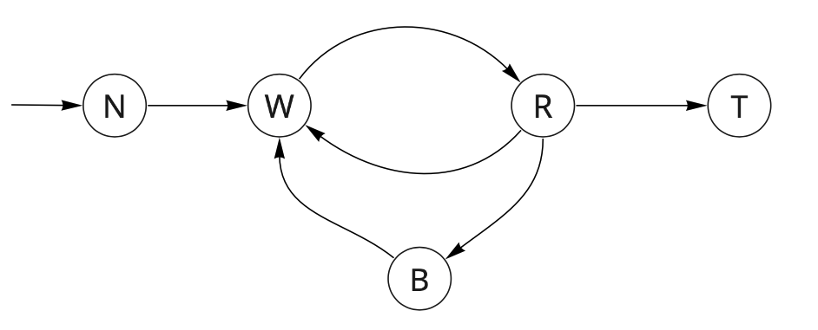
Process Status Diagram
dispatch
admit
exit
interrupt
Control of the computer moves through a well-defined cycle
Transitions:
admit: A request is made to allow your program to content for control
dispatch: Your program is given control
exit: Your program asserts that it is done
interrupt: The OS seizes control
trap: Your program (implicitly or explicitly) requests a service to be performed
completion: The request is satisfied
Traps are calls to the Kernel (the OS)
completion
trap

Slide 3
MIPS System Calls: SystemCallAPI.png
print integer
print float
print double
print string
read integer
read float
read double
read string
allocate memory
terminate
print character
read character
file open
file read
file write
file close

Slide 4
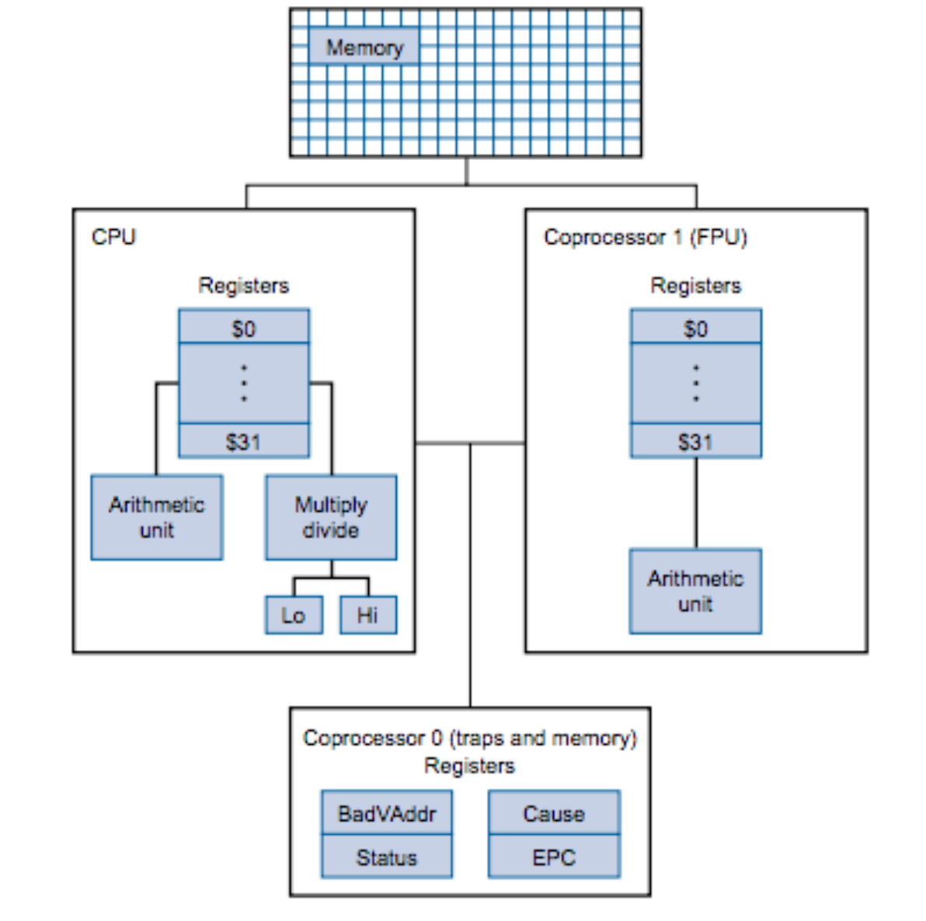
MIPS Instruction Set Architecture (ISA)
x86: has 4 general purpose registers
General Architecture
RISC (Reduced Instruction Set Computer)
Simple Instructions
Lots of Registers
Remember Memory is SLOW!
Instruction Set:
List of Instructions Supported by the Architecture
MIPS Cheat Sheet
Memory
CPU
ALU
32 general purpose registers
Coprocessors
Floating point
Traps, Exceptions, Interrupts

Slide 5
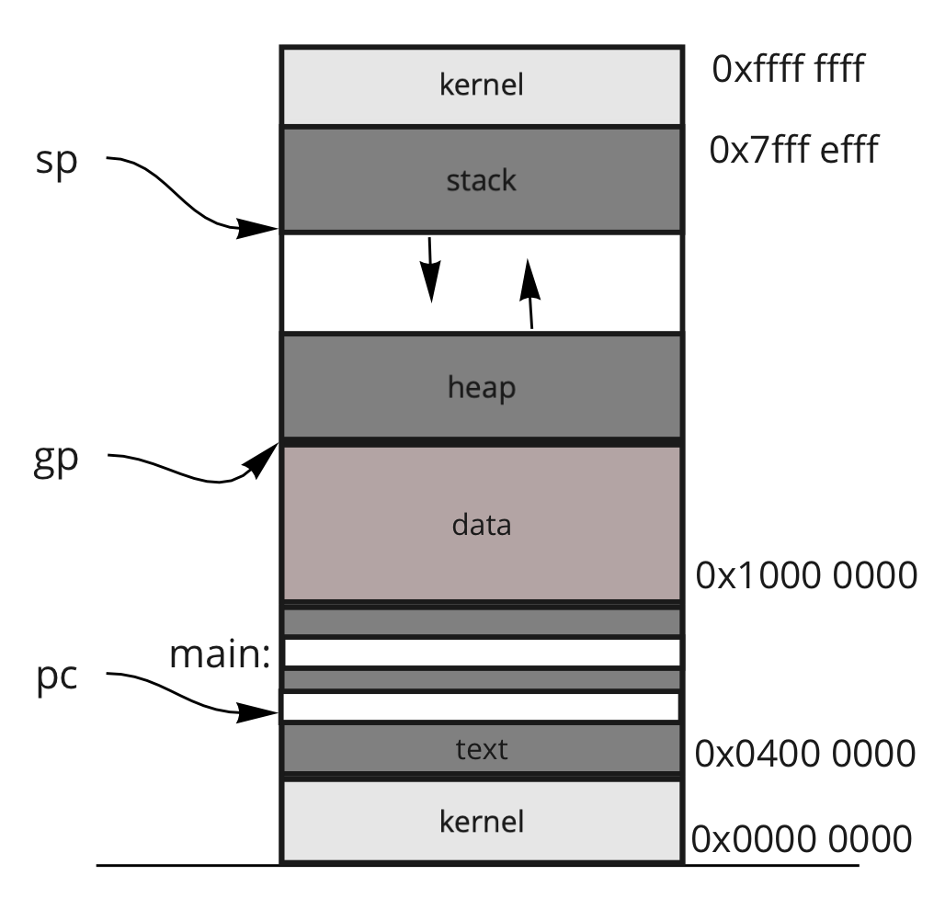
Main Memory
current address saved in a register
well-known addresses
View & Orientation
Array of Bytes: (i.e., byte addressable)
Data Segments: (to name a few)
.text
.data
.lit4, .lit8 (4 and 8 byte literals)
.bss (block storage)
heap
stack
Data Declarations and Sizes
.byte, .half, .word
.ascii, .asciiz
.float, .double
.space
Alignment
Endianness

Slide 6
Data Declarations and Alignment
'c'
0x00
'a'
'r'
0
0x04
4
4
10
1
1
+ 1
-----
21
string: .asciiz "car"
sum: .word 0x00 00 AF 02
buffer: .space 10 # buffer[0] ... buffer[9]
checksum: .byte 'a'
complement: .byte 0x0
dummy: .byte
half: .half
# needs to be aligned
0
0
Alignments:
byte aligned (1)
half aligned (2)
word aligned (4)
paragraph aligned (16)
page aligned (64K)
Foreshadow
Virtual Memory
Paging Systems
Fragmentation (wasted space)
AF
02
0x08
61
0x12
0
0x13
0x14
0x16
You have a carton of size 14, and boxes of sizes: 1, 5, 5, 6 & 6
How many boxes can you place in the carton?
empty slot

Slide 7
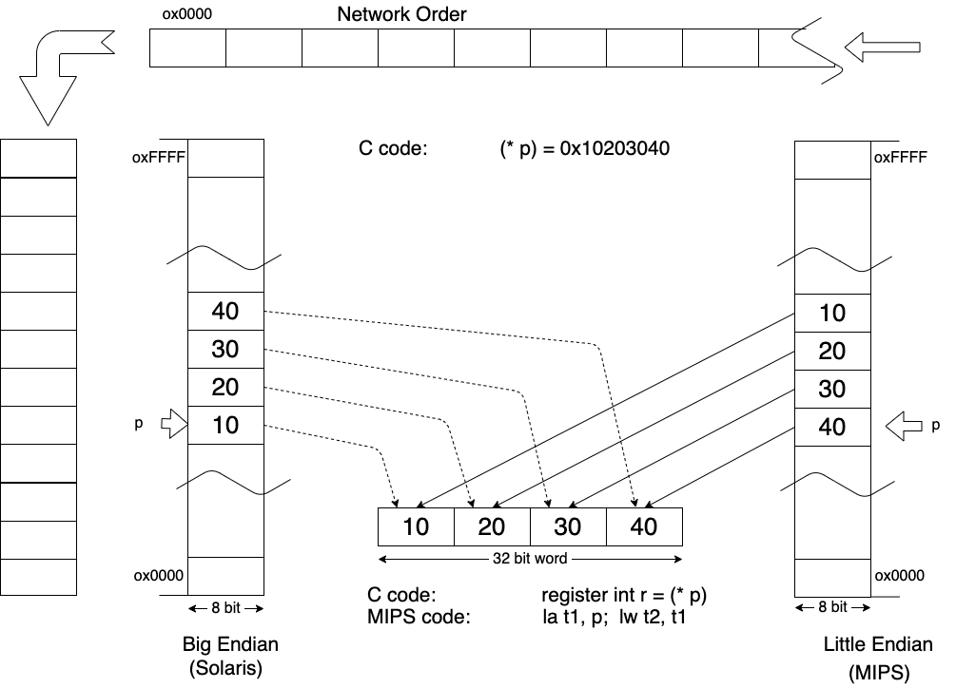
Endianness
The order of bytes within a word
Network Order
Big Endian
Host Order
Big Endian
Little Endian

Slide 8
Addressing Modes
var1: .word 0xface var2: .half 0x22
lst: .space 10
Registers are prepend with a dollar sign, literals are not
ARM: literals are appended by a sharp, registers are not.
immediate: is when the actual value is one of the operands.
li $t0, 57 add $t0, $t0, 57
direct: is when the register or memory location contains the actual values.
lw $t0, var1 lh $t1, var2
indirect: the ()'s are used to denote indirect memory access.
li $s1, 0x3 la $t0, lst sb $s1, 5($t0)
var1:
f
a
c
var2:
e
2
lst:
2
lst[0]
lst[1]
lst[2]
lst[3]
lst[4]
lst[5]
3
lst[6]
lst[7]
lst[8]
lst[9]
$t0
lst[5] = 0x3
Think of this as an array, but with a different syntax: list[5] ⇔ 5(list)
$t0[4] ⇔ 4($t0)

Slide 9
Registers
System
PC: Program Counter
IR: Instruction Register
BadVAddr: memory address where exception occurred
Status: Interrupt mask, enable bits and status when exception occurred
Cause: Type of exception
EPC: Address of instruction that caused the exception
Reserved (Don't use!)
$at: reserved for the Assembler
$k1, $k2: reserved for the Kernel
$gp: global pointer defined by the compiler
Special (Access via specific instructions)
PC: program counter
hi, lo: used double word results
(hi, lo) = val1 * val2
(hi, lo) = val1 % val2
General Purpose
32 32-bit integer registers: $0..$31
32 32-bit floating point registers: $f0..$f31

Slide 10
General Purpose Registers
Name | Register Number | Usage
$zero | 0 | constant 0 (hardware)
$v0 - $v1 | 2 - 3 | subroutine return values
$a0 - $a3 | 4 - 7 | subroutine arguments
$t0 - $t7 | 8 - 15 | temporaries
$s0 - $s7 | 16 - 23 | saved temporaries
$t8 - $t9 | 24 - 25 | temporaries
$sp | 29 | stack pointer
$fp | 30 | frame pointer
$ra | 31 | return address (hardware)

Slide 11
Subroutine Calls
Subroutine: generic term for: function, procedure, method, whatever!
If you are a good programmer, you have
many or few subroutines?
Frame of Memory for a subroutine
input arguments are placed onto the stack
local variables are placed onto the stack
any tempories are placed onto the stack
Where does the return value go?
Remember Memory is SLOW!
int f (int A1, int A2, int A3); int g (int A1);
int f(int A1,int A2, int A3) { int L1;
L1 = <some calculation> { int L3 ;
L3 = A1 * L1 + g(A2+L2); L1 = L3 | A3 } return (L1);
}
fp:
L1
args
locals
temps
sp:
args
locals
temps

Slide 12
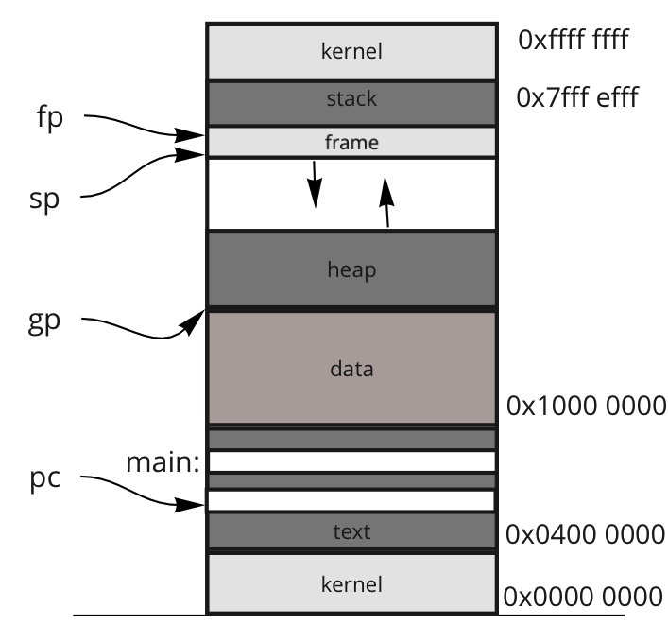
CPU General Purpose Registers: ($0 -- $31)
Memory Organization
$t0 - $t9: temporary registers
$zero: holds the value 0
All needed literals must be stored in memory
But memory is slow, so keep 0 in a register
$s0 - $s7: saved registers
Subroutine Specific
$v0 - $v1: return values
$a0 - $a3: input arguments
Special Usage:
$sp: stack pointer
$fp: frame pointer
$ra: return address
x = f(a, b)
fp:
args
locals
N
temps
sp:

